Slide 1


IDS 1721
Computing and Problem Solving for STEM
Chapter 05
Abstraction

Slide 2
Chapter 5: Abstraction
In this lecture we will design a function for computing square roots that is based on a rectangle averaging process. The fact that sqrt is a built-in function gives us a standard against which we can measure the quality of our implementation.

Slide 3
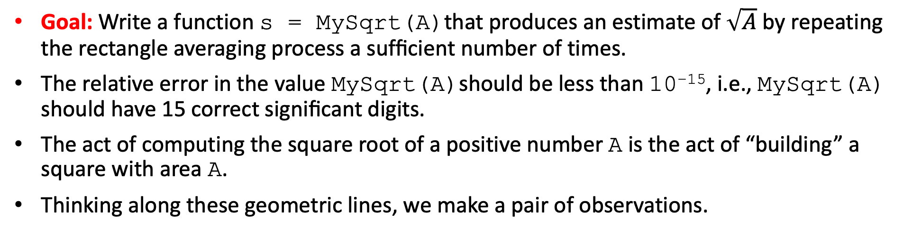
Chapter 5: Abstraction
Reshaping Squares
Goal: Write a function s = MySqrt(A)that produces an estimate of $\sqrt{A}$ by repeating the rectangle averaging process a sufﬁcient number of times.
The relative error in the value MySqrt(A)should be less than 10⁻¹⁵, i.e., MySqrt(A) should have 15 correct signiﬁcant digits.
The act of computing the square root of a positive number A is the act of “building” a square with area A.
Thinking along these geometric lines, we make a pair of observations.

Slide 4
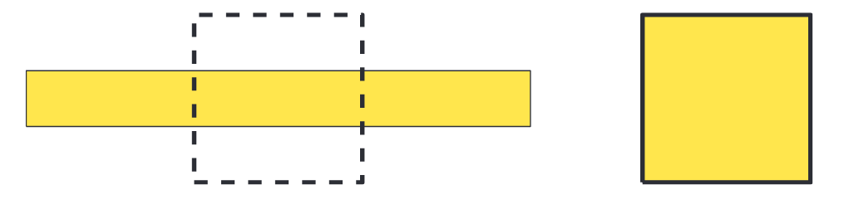
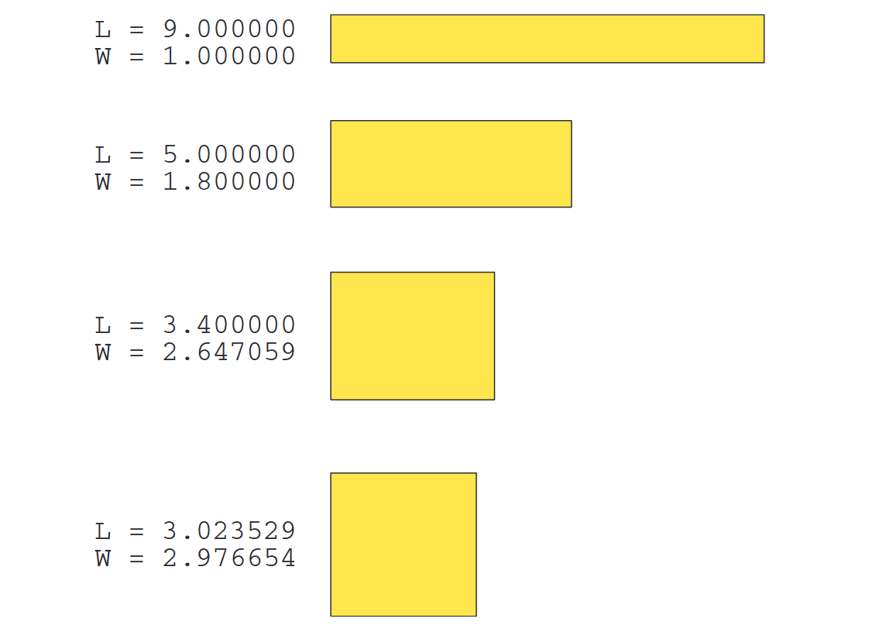
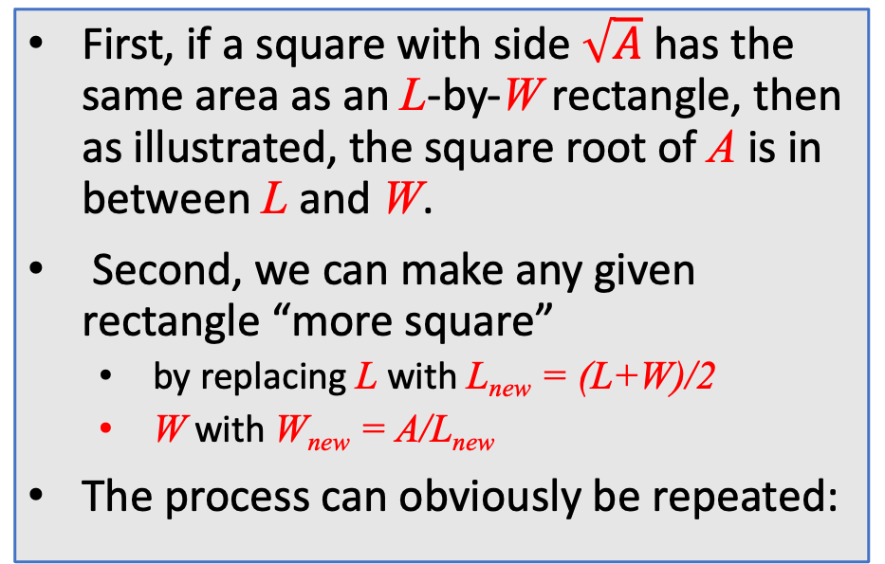
Chapter 5: Abstraction
Reshaping Squares
First, if a square with side $\sqrt{A}$has the same area as an L-by-W rectangle, then as illustrated, the square root of A is in between L and W.
Second, we can make any given rectangle “more square”
  by replacing L with L_{new} = (L+W)/2
  W with W_{new} = A/L_{new}
The process can obviously be repeated:

Slide 5
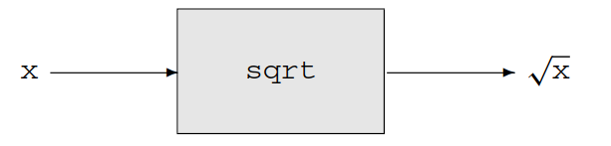
Chapter 5: Abstraction
Reshaping Squares
Before we develop MySqrt, let us think a little bit about the MATLAB built-in function sqrt. It can be visualized as a “black box” with an input and an output:
A nonnegative number arrives at the “front door,” mysterious things happen, and out pops the square root.
As users of sqrt, we do not have to worry about the mysterious inner workings of sqrt, i.e., it can be treated as a black box.
However, we do have to “read the manual” about sqrt so that we can use it properly. The MATLAB help facility is designed for this purpose.

Slide 6
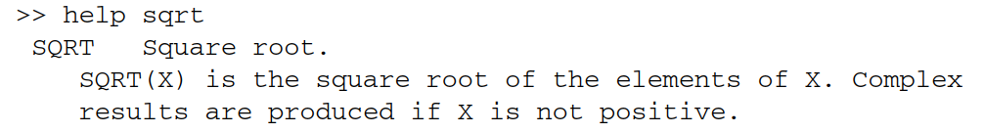
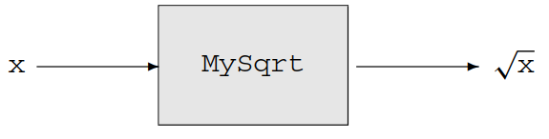
Chapter 5: Abstraction
Reshaping Squares
From the command window we ﬁnd
The language here is a little confusing because sqrt can accept a vector, a feature that we ignore for now.
But the message is important. Writing a description on how to use a function is as critical as designing the function itself.
Our plan is to write our own version of sqrt and call it MySqrt. To the user, it will look the same:

Slide 7
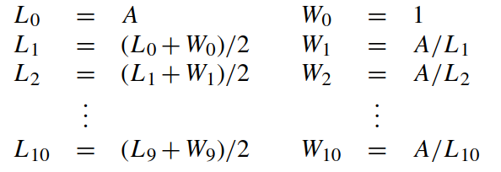
Chapter 5: Abstraction
The inner workings of MySqrt become our responsibility and that is where we start.
After code is developed that implements the rectangle averaging process outlined above, we “package it up” as a function that can then be used just like sqrt.
We’ll deﬁne L_{i} and W_{i} to be the length and width of the rectangle after i averaging’s.
We’ll examine the quality of the approximation after ten iterations.
Our improvement sequence is as follows:

Slide 8
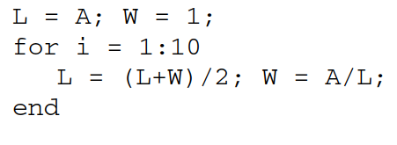
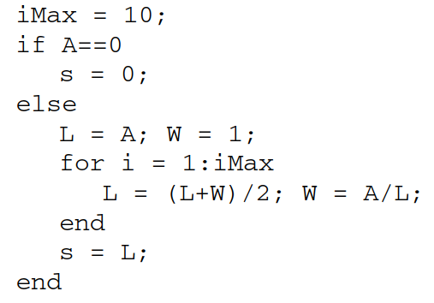
Chapter 5: Abstraction
Reshaping Squares
It can be coded into a short loop
We are assuming that A is initialized
What about if A =0?
Ten iterations might not be enough, let’s use a new variable iMax to adjust the limit
s is the length of the final rectangle

Slide 9
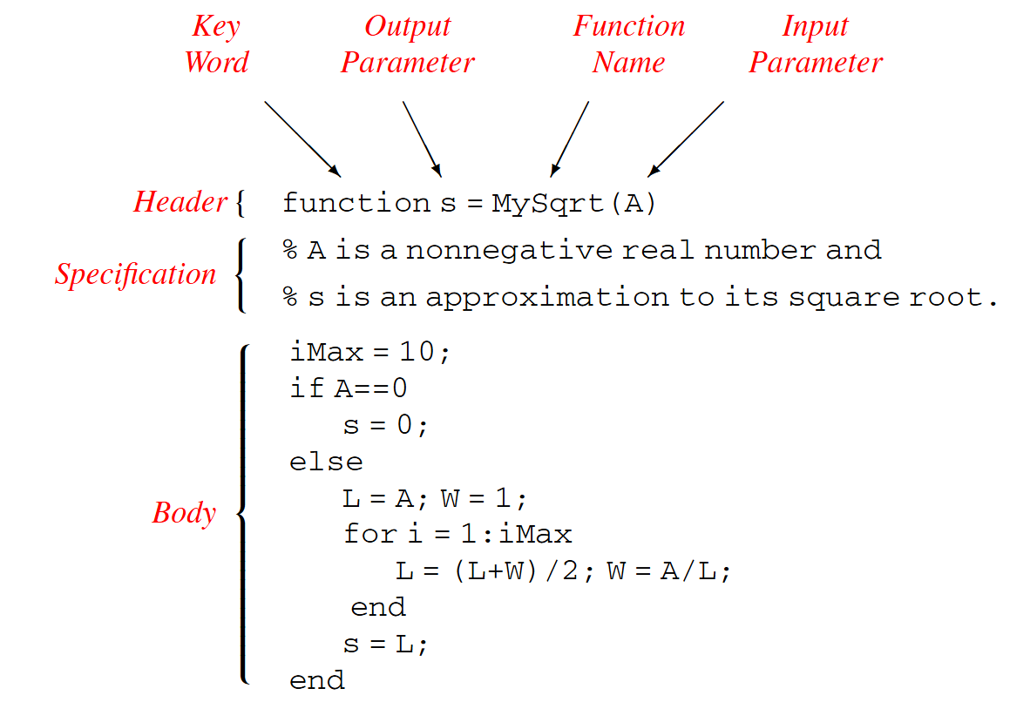
Chapter 5: Abstraction
Reshaping Squares
Recall that the function header begins with the keyword function.
A function must have a name, and the naming conventions are the same as for variables.
Admissible characters include letters (upper- or lowercase), digits, and the underscore, and the ﬁrst character must be a letter.
The file name must match the function name…

Slide 10
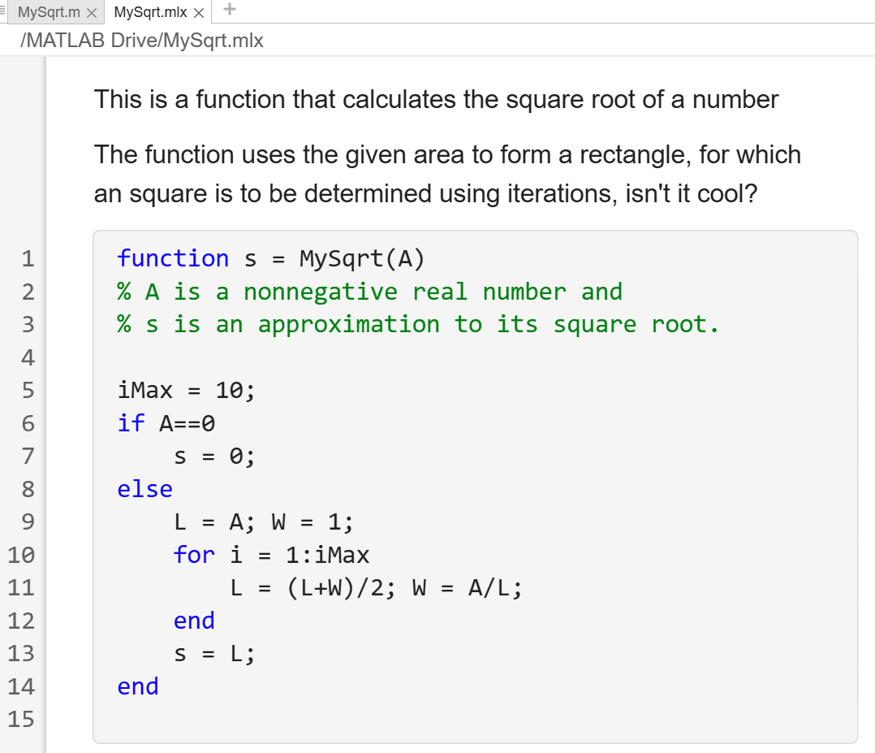
Chapter 5: Abstraction
Reshaping Squares
Next in the derivation of MySqrt comes the packaging part.
It involves prefacing the above implementation with a function header and placing everything in a MATLAB-ﬁle, MySqrt.m as shown.
The various parts that make up a function are indicated…
Code it up!
>> edit MySqrt.mlx

Slide 11
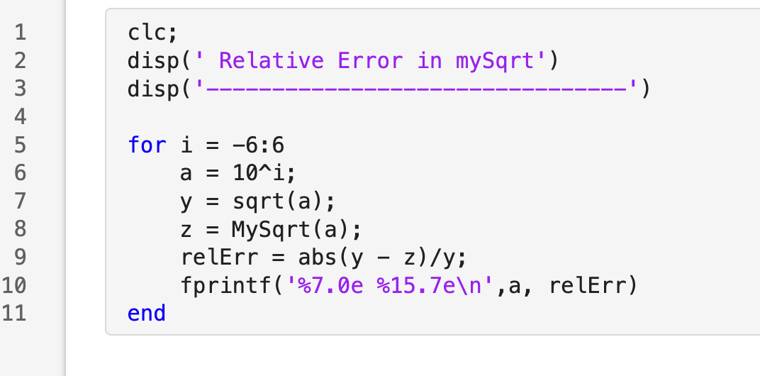
Chapter 5: Abstraction
Reshaping Squares
To understand how functions work, we consider the following script which compares MySqrt(a) and sqrt(a) over a range of input values.
The relative error is the “percent error”—the absolute error divided by the “true” value.
Notice, we are “calling” our customized function within the script…
This is analogous to calling a built-in function such as sin(x) or sqrt(x) – like shown here…

Slide 12
Chapter 5: Abstraction
Reshaping Squares
Let’s code it up!
>> edit sqrtCompare.mlx

Slide 13
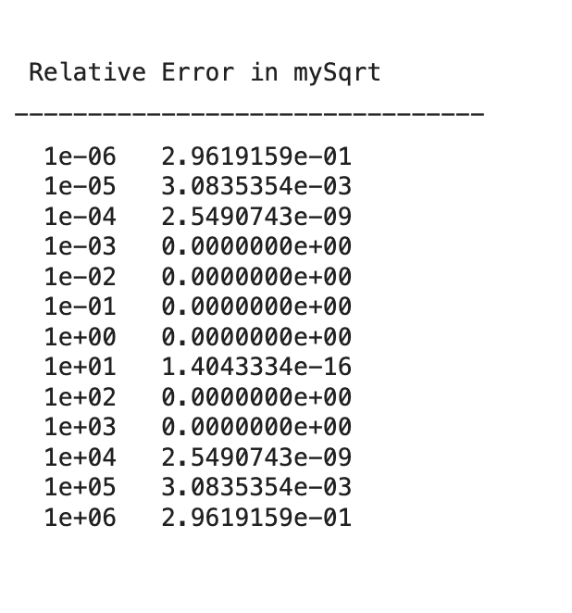
Chapter 5: Abstraction
Reshaping Squares
Increasing error
No error
Increasing error
Accuracy is not that good, yet, let’s explore why

Slide 14
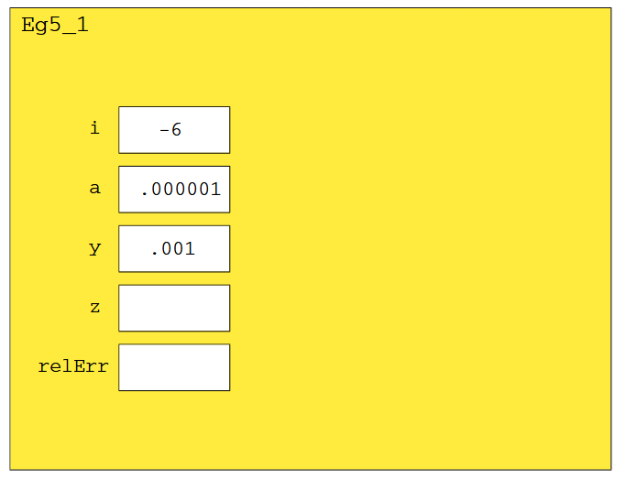
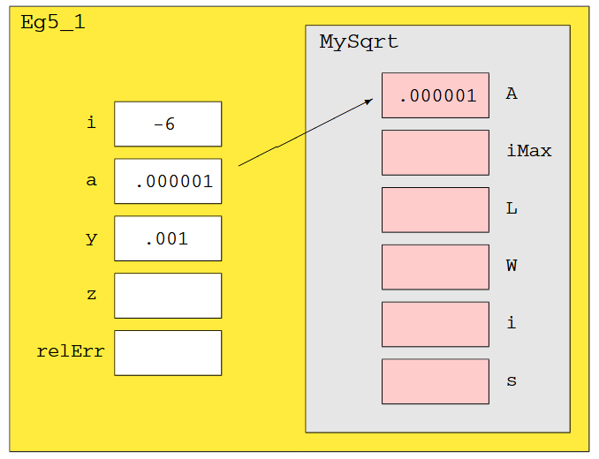
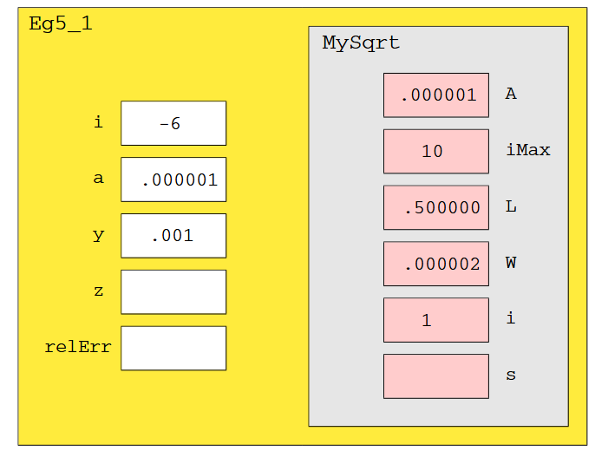
Chapter 5: Abstraction
Reshaping Squares
Step 1
Command window is cleared
Table headings are shown
For-loop starts: i=-6 & a=10^{i}
sqrt = 0.001 and assigned to y
Step 2
z = MySqrt(a) calls the function
MySqrt function starts
The a value is passed as A
Step 3
MySqrt function runs
Values are initialized
1st run of the for-loop
The initialization W=1 gets the approximate value far from the actual square root

Slide 15
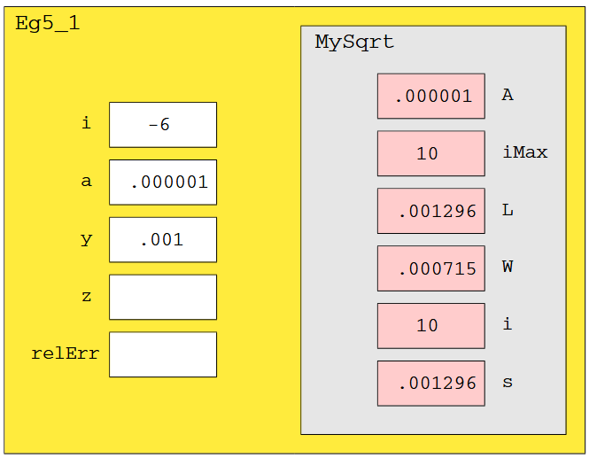
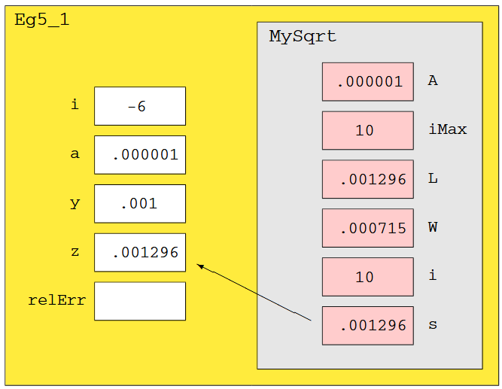
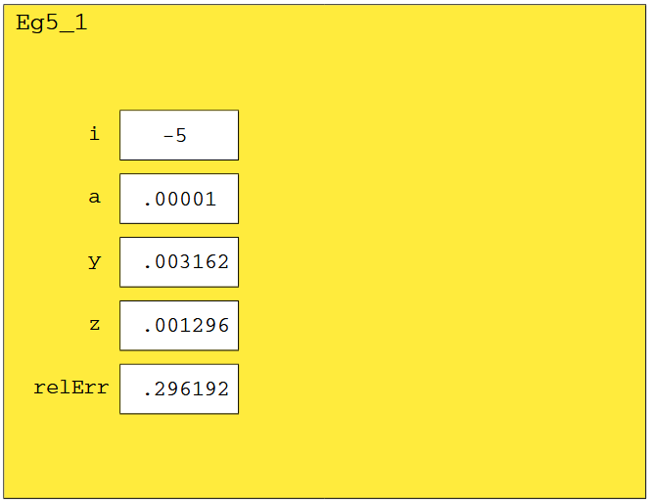
Chapter 5: Abstraction
Reshaping Squares
Step 4
The MySqrt function finishes and the final value of L is assigned to s
L and W are not identical!
Step 5
The s-value, the output, is passed back to the script
z = MySqrt(a) is complete
The function call is over
Step 6
Content from MySqrt disappears
The main script resumes
Error is calculated and printed
Second run starts at i=-5

Slide 16
Chapter 5: Abstraction
Reshaping Squares
The main script calls MySqrt thirteen times, meaning that control passes back and forth thirteen times. The communication takes place only through the input and output parameters. The computations inside MySqrt are “insulated” from the calling script.
What about accuracy? One solution is to increase the value of iMax, but there are two problems associated with a large iMax.
The ﬁrst concerns efﬁciency. Many more iterations than necessary will be carried out for “nice” input values that do not require a huge number of rectangle averagings.
Second, no matter how large we make iMax, there will always be a range of input values upon which we will get poor results.
The way out of this situation is to use a while-loop.

Slide 17

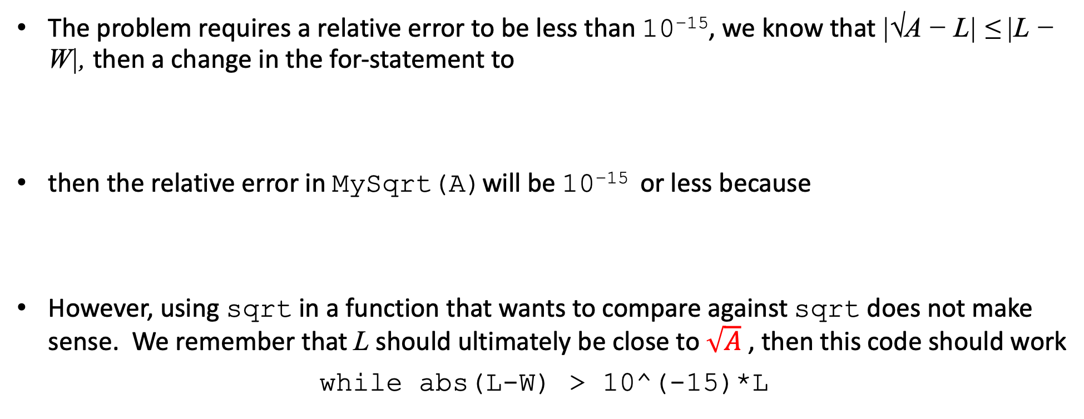
Chapter 5: Abstraction
Reshaping Squares
The problem requires a relative error to be less than 10⁻¹⁵, we know that |√A − L| ≤ |L − W|, then a change in the for-statement to
then the relative error in MySqrt(A)will be 10⁻¹⁵ or less because
However, using sqrt in a function that wants to compare against sqrt does not make sense. We remember that L should ultimately be close to $\sqrt{A}$, then this code should work
while abs(L-W) > 10^(-15)*L
Let’s modify our mySqrt function…

Slide 18
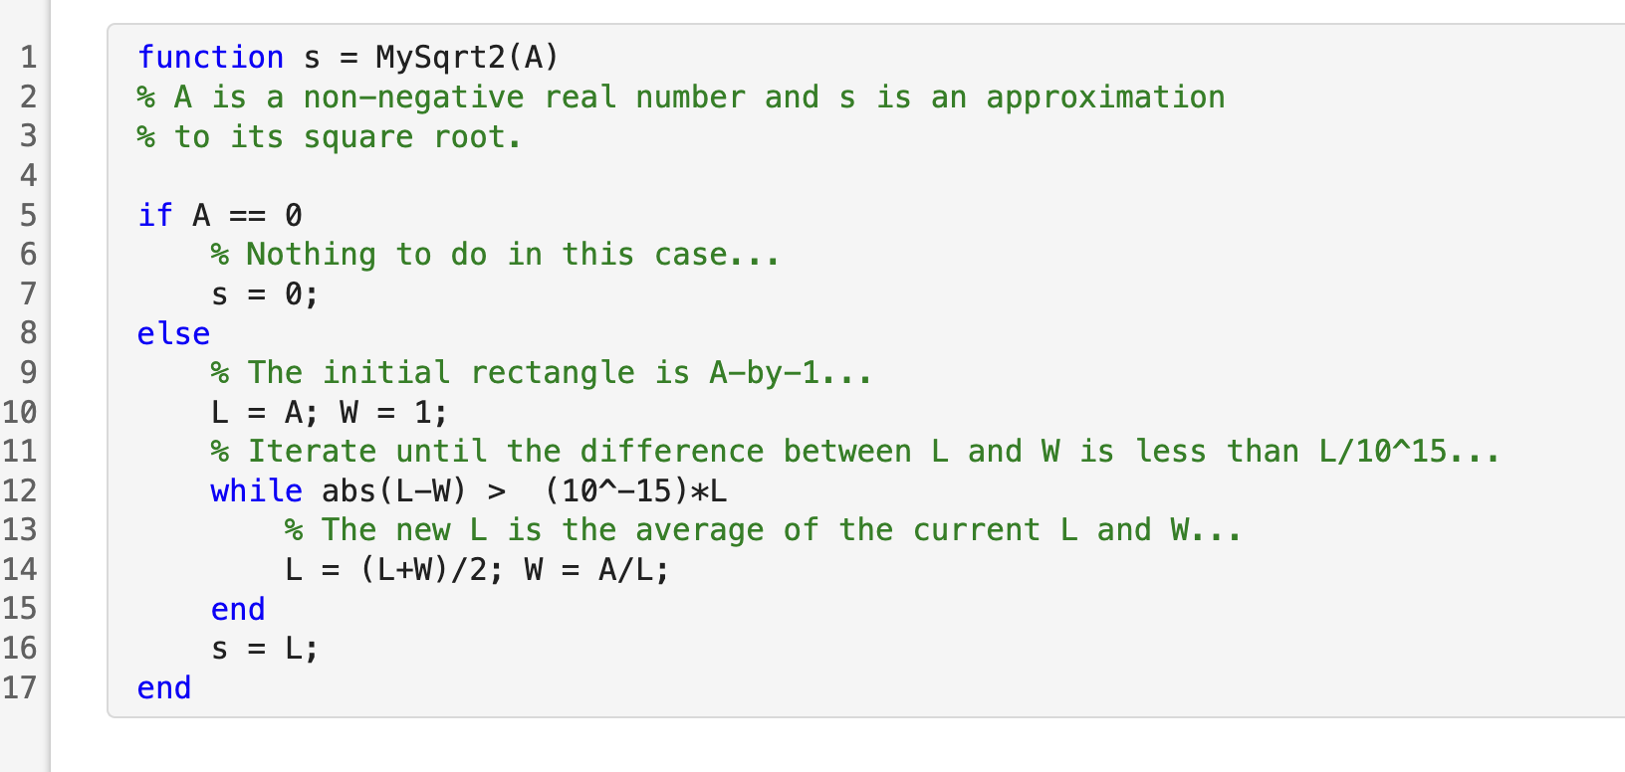
Chapter 5: Abstraction
Reshaping Squares
>> edit mySqrt2.mlx

Slide 19
Chapter 5: Abstraction
Designing a Function
>> edit mySqrt2.mlx

Slide 20
Chapter 5: Abstraction
Designing a Function
>> edit mySqrt2.mlx

Slide 21
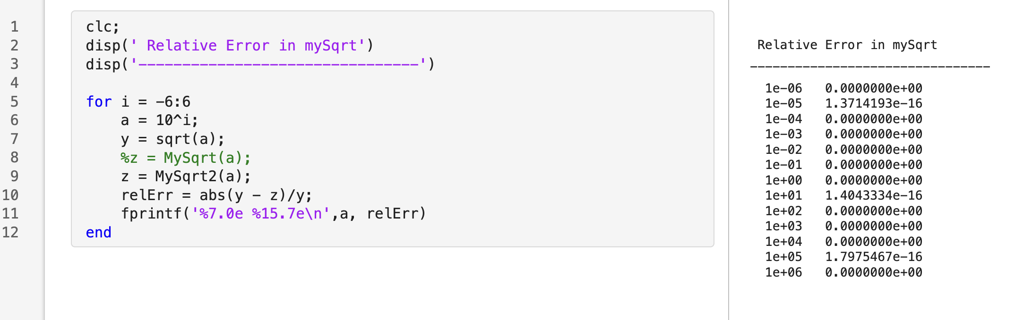
Chapter 5: Abstraction
Designing a Function
Modify your sqrtCompare.mlx script and run!

Slide 22
Chapter 5: Abstraction
Designing a Function
Error is a LOT better!

